Slide 1
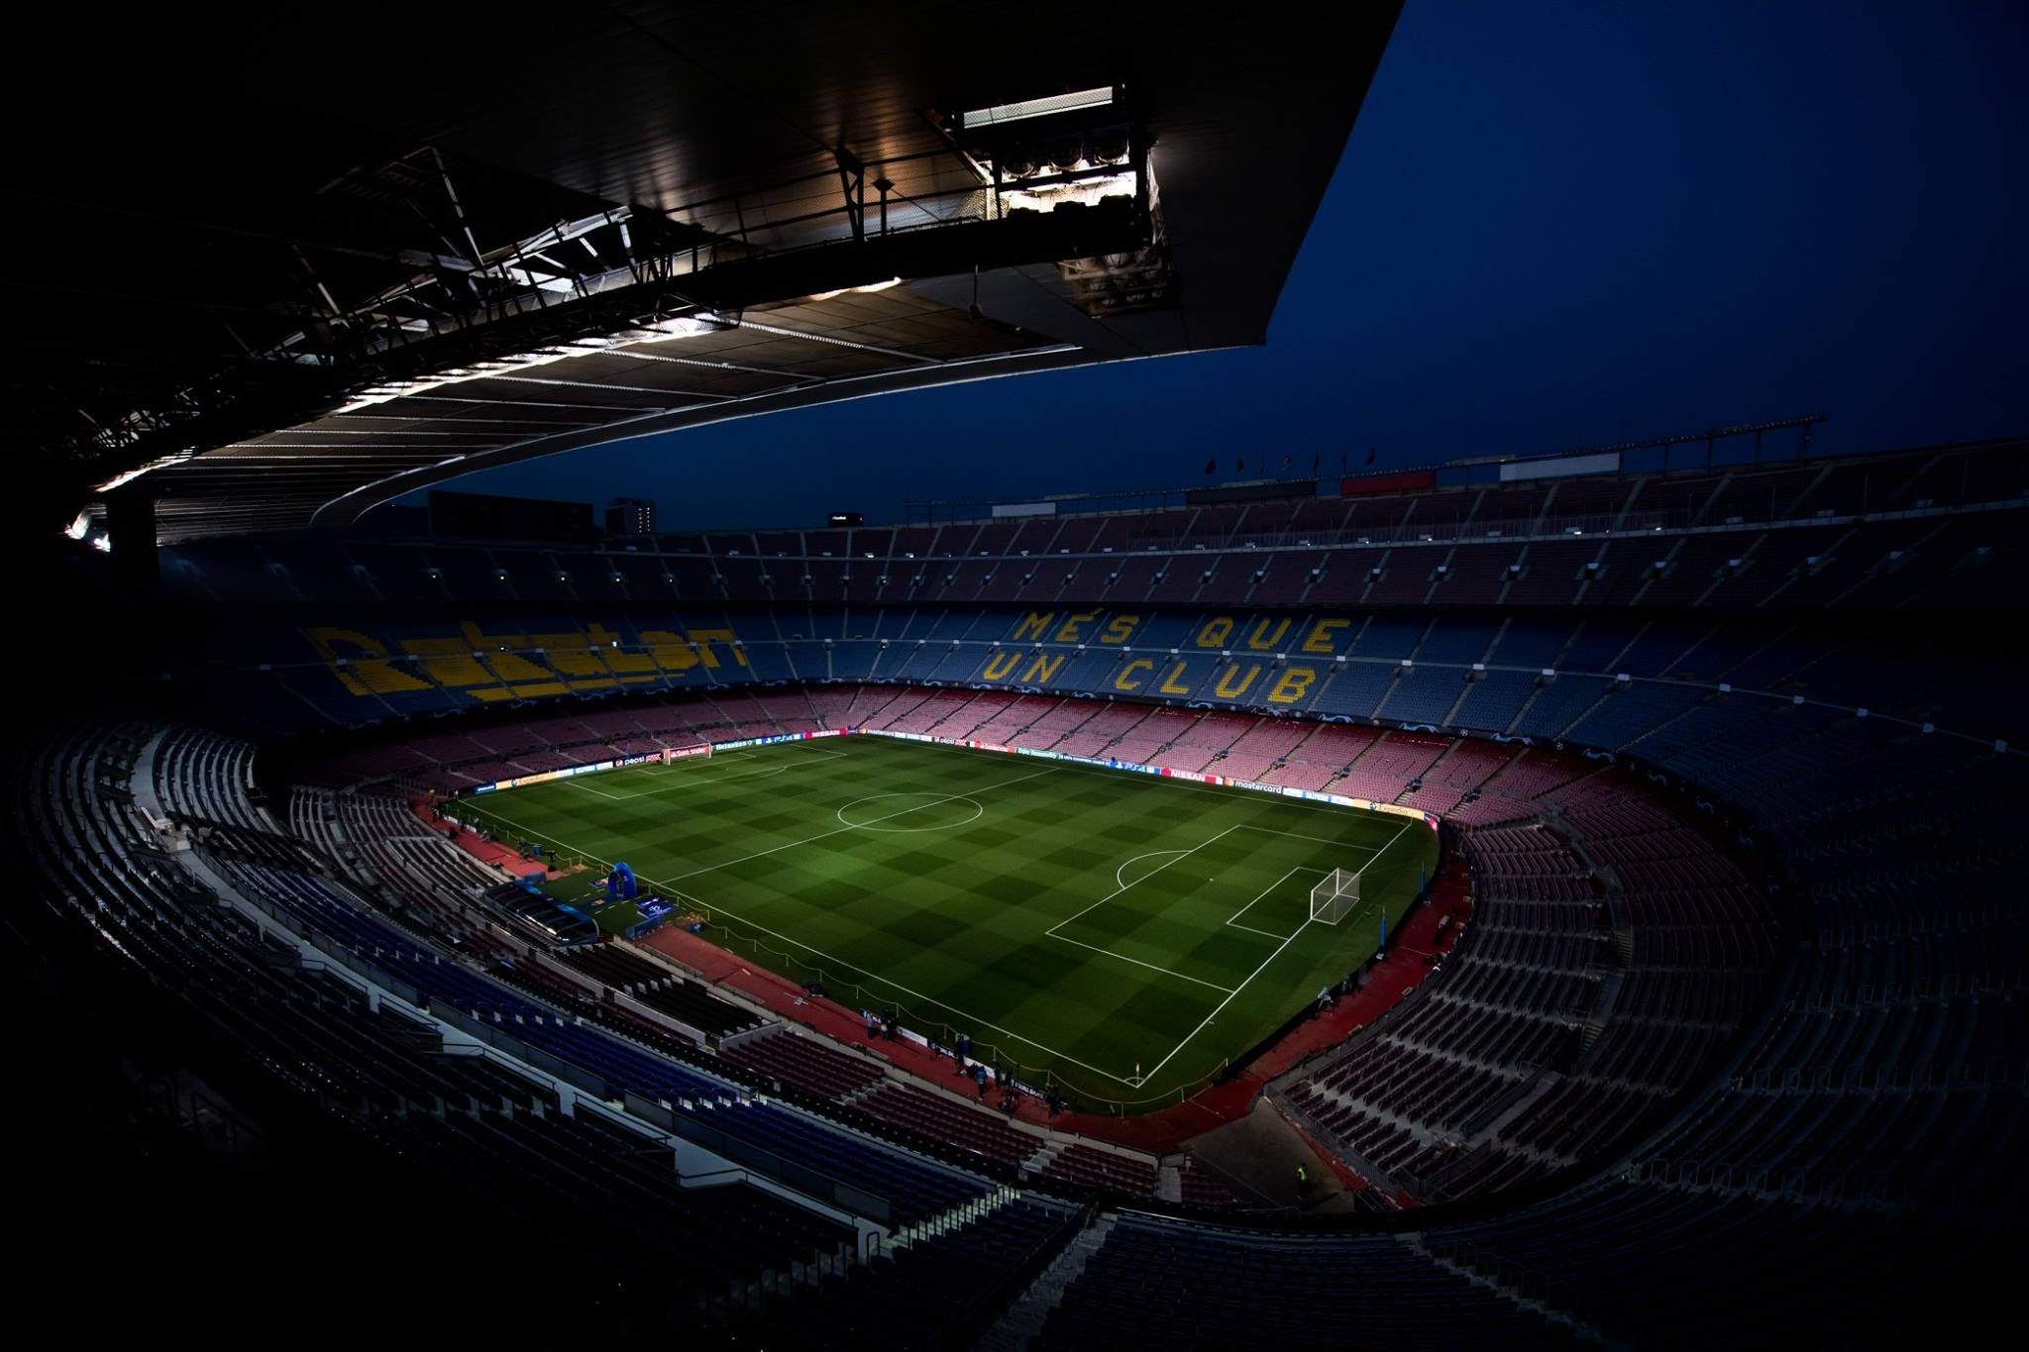

AI IN FOOTBALL
A GUIDE TO EXPECTED GOALS (XG)
AYUSH MARIA
GUIDED BY DR.JUN LI

Slide 2
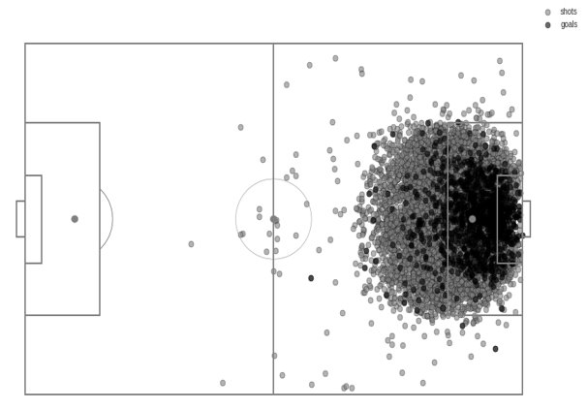

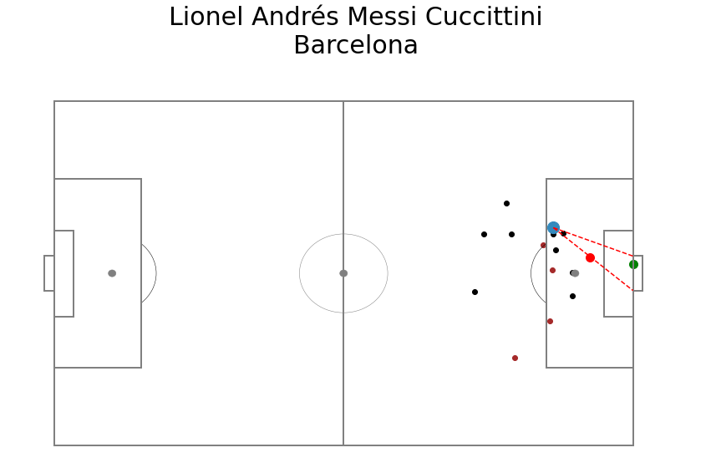
What is xG?
A metric that quantifies the quality of any given football shot during a football match, irrespective of the player that shoots it.
This quality is provided by the probability of the shot being a goal, based on the events surrounding the shooter during the match.
Some examples of the events can be the players surrounding the ball and the pressure they maintain on the shot taker and the play pattern preceding the shot
Other examples of the physical attributes can be the distance of the shot taker from the goal and the angle at which the shot is taken

Slide 3


IT ALL STARTS WITH THE TOSS OF A COIN

Slide 4

A Game of Probability
“Expected goals” is similar to the mathematical concept of “expected value” and it is a measure of the likelihood of an outcome occurring.
The expected value of a fair coin toss is 50% likely to land on heads and 50% likely to land on tails (thus expected heads or tails is 0.5).
We are not expecting exactly half of our tosses to give either outcomes each time, while over a larger number of coin tosses, it is likely to maintain this measure.
Variance from this expected value is unavoidable. This is valuable information which we can analyze in football.

Slide 5
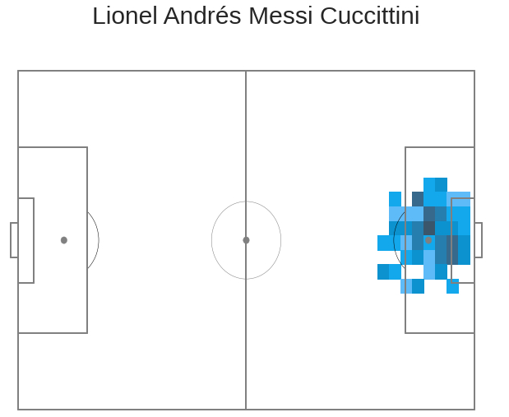
How is Expected Goals (xG) used?
Differentiate between players with similar performances
Identify important tactical points that benefit the team
Identify potential transfer market targets
Determine the play style of football players

Slide 6
Workflow
Data Cleaning/Wrangling
Exploratory Data Analysis
Feature Engineering and Hyperparameter Optimization
Machine Learning

Slide 7

Data Cleaning/Wrangling
The data is obtained in .JSON format.
Three different categories of data were used:
Competition Data
Match Data
Event Data
All these datasets contain specific IDs describing distinct competitions, matches and events.

Slide 8
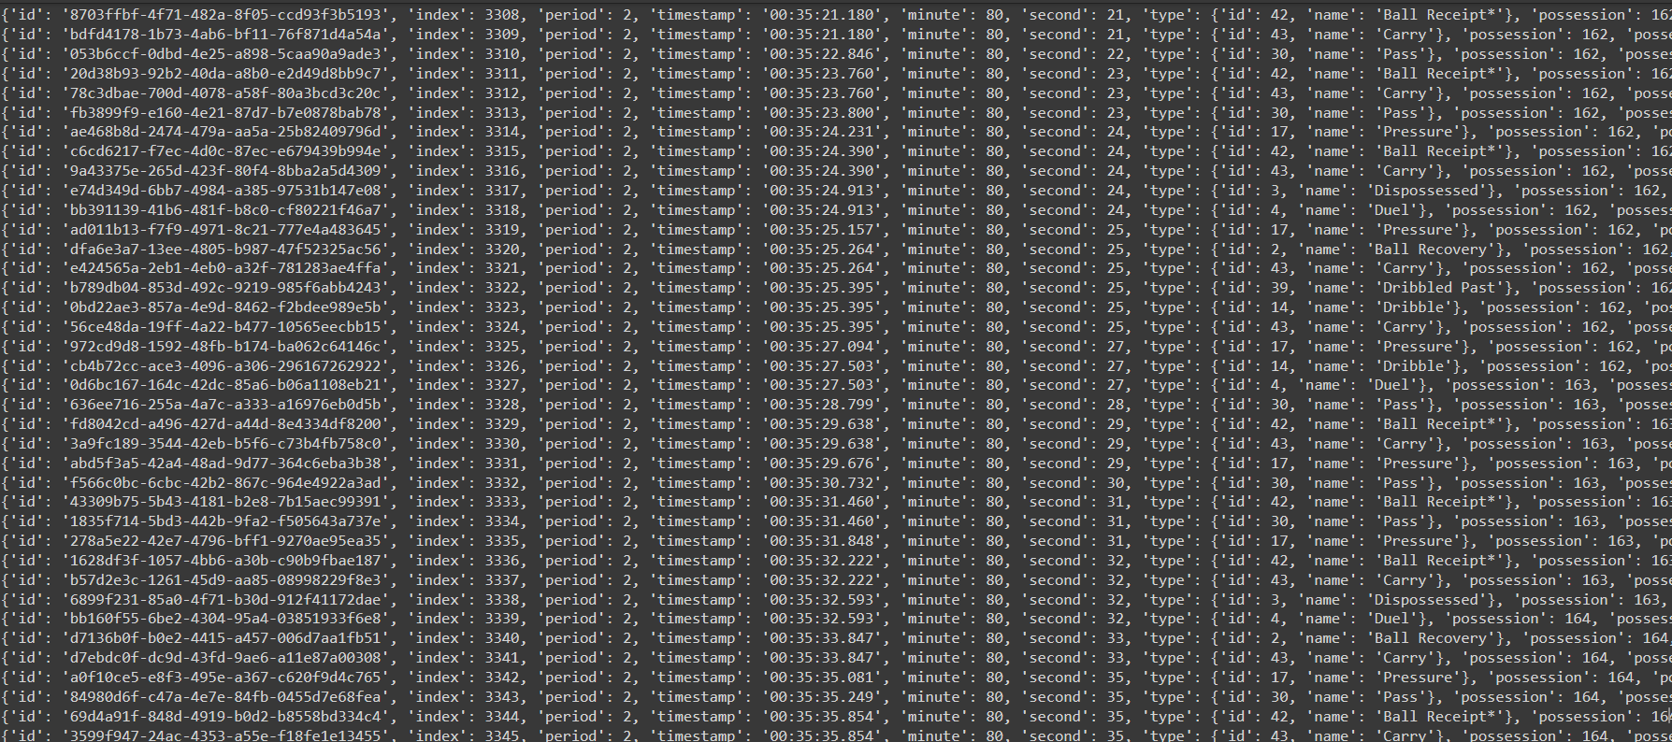
Event Data

Slide 9
Extracted Data
Shot Id
Play Pattern
X Location Shot
Y Location Shot
Duration
Outcome
Technique Used
First Time
X GK Location
Y GK Location
Body Part
Type of Shot
Player Name
Team Name
Official xG
Pass id
Pass Type

Slide 10
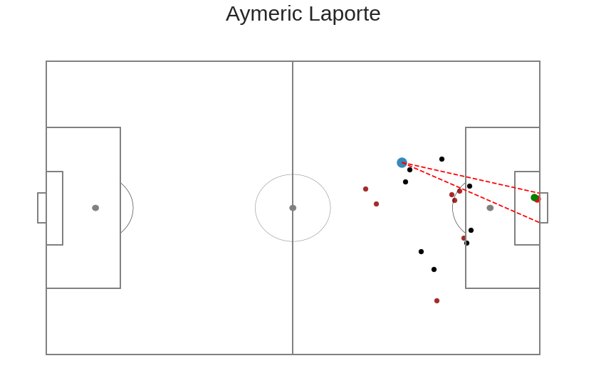
Engineered Data
Number of opponents in 5 yards
Players between goal
Shot Distance
Goalkeeper Distance
Shot Angle
Binary Outcome
Goal Label

Slide 11
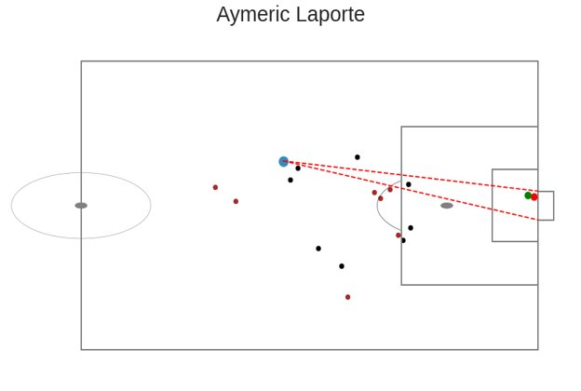
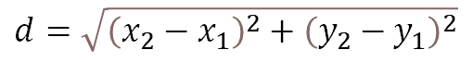
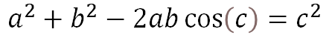
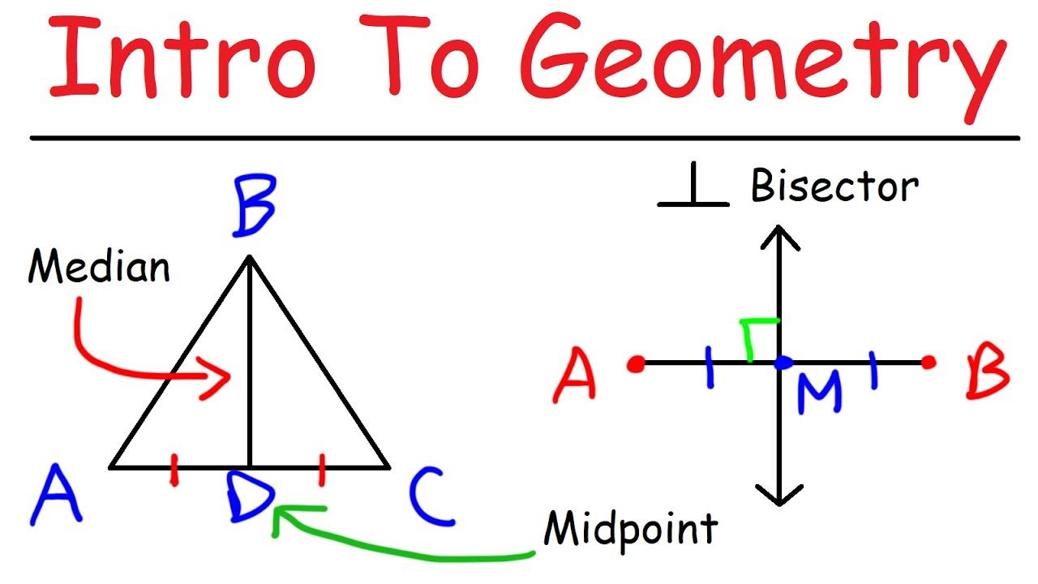
Mathematics101
2D Distance Formula
Law of Cosines

Slide 12
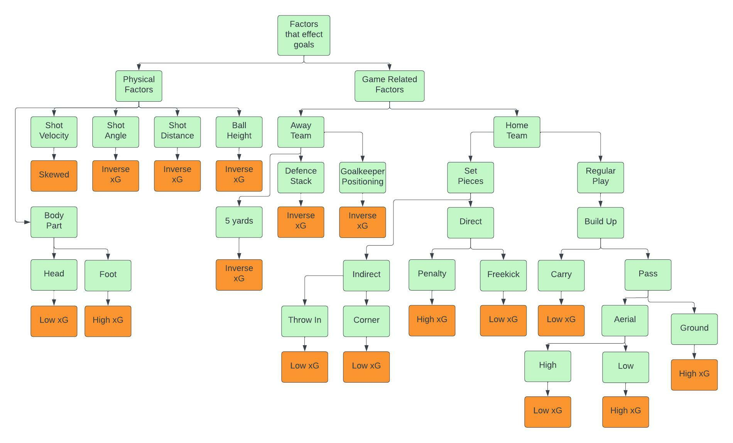
Hypothesized Features for xG

Slide 13
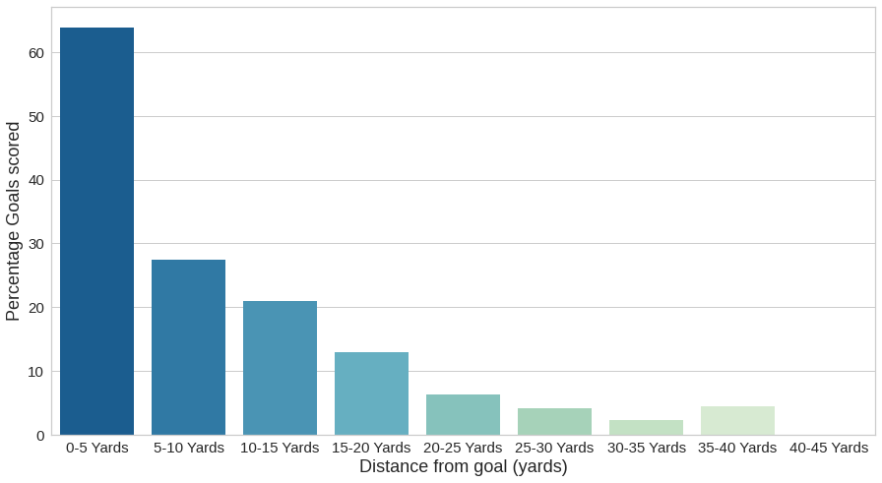
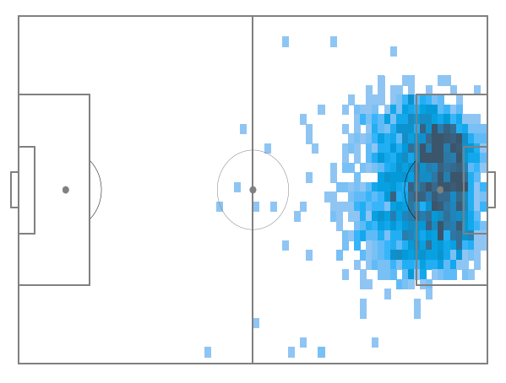
Impact of Shot Distance

Slide 14
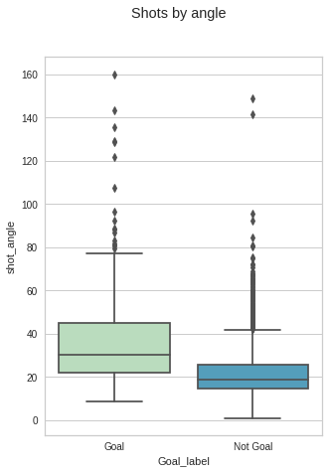
Impact of Shot Angle

Slide 15
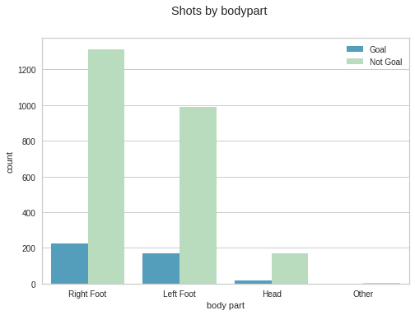
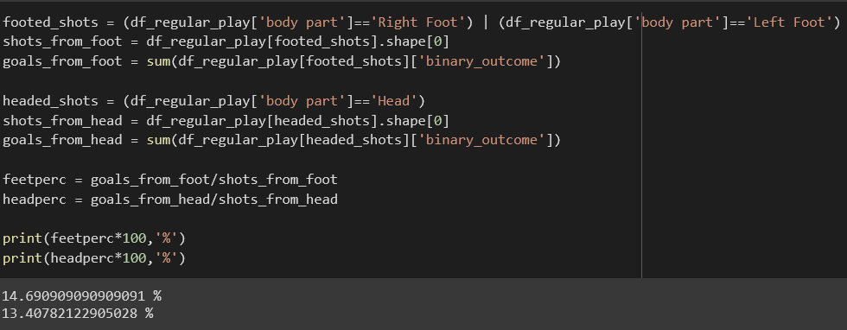
Impact of Body Part

Slide 16
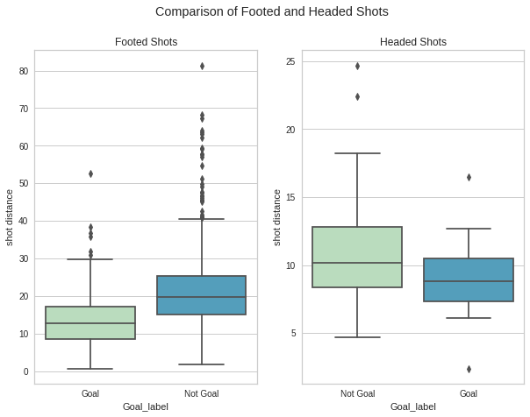
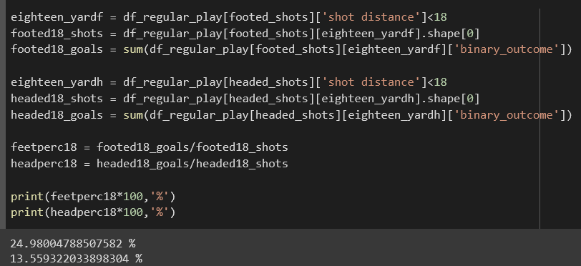
Impact of Body Part

Slide 17
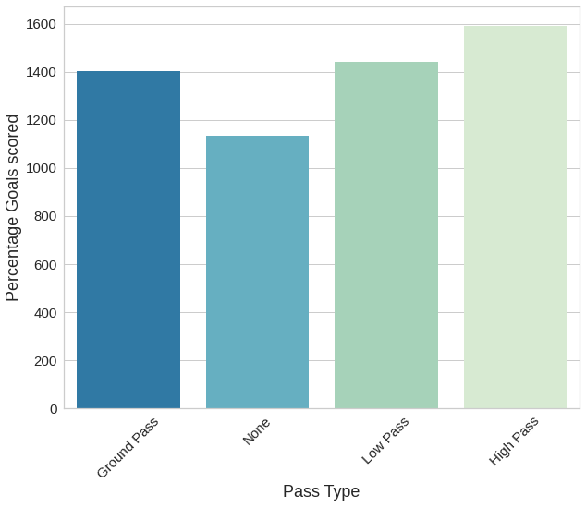
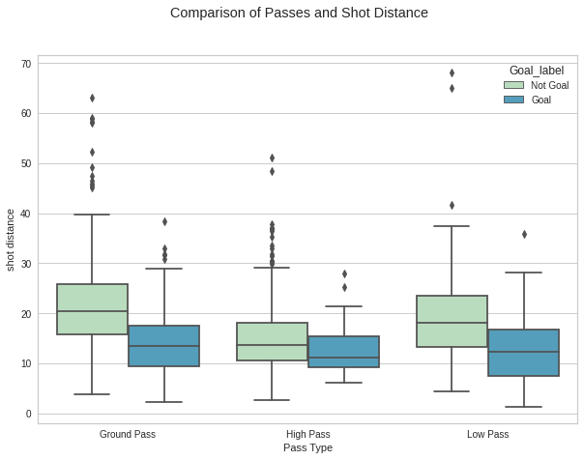
Impact of Pass Type

Slide 18
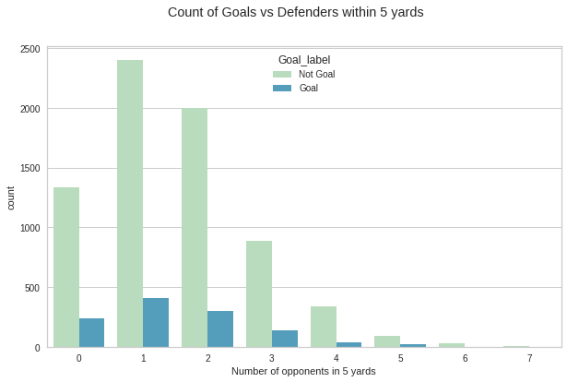
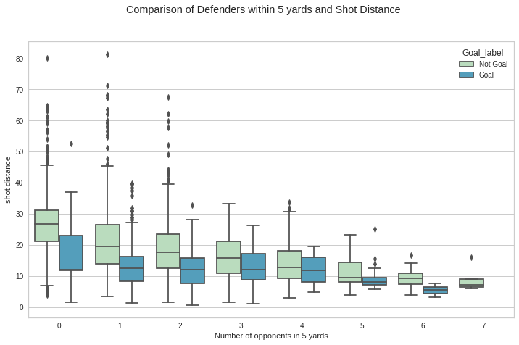
Impact of Pressure within 5 yards

Slide 19
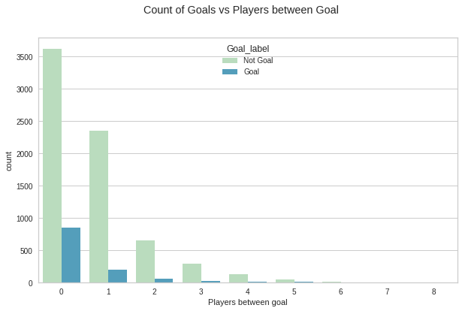
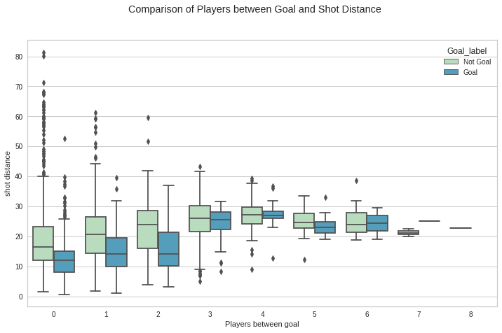
Impact of Players between Goal

Slide 20
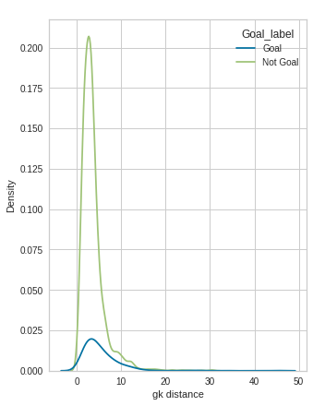
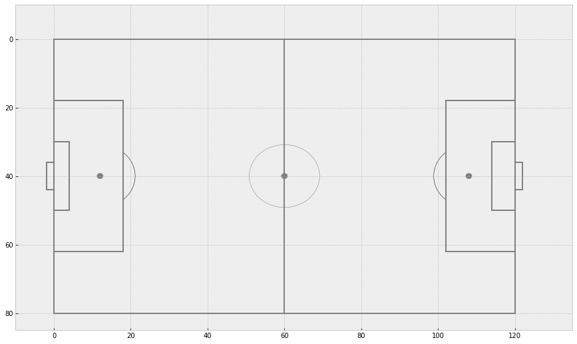
Impact of Goalkeeper location

Slide 21
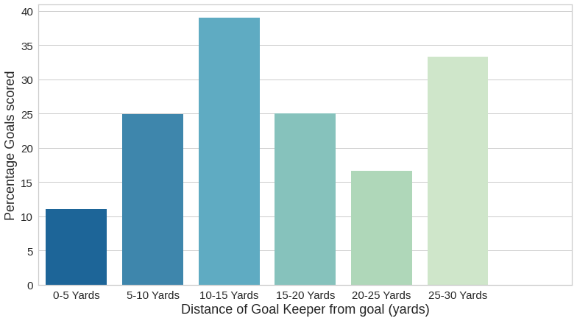
Impact of Goalkeeper location

Slide 22
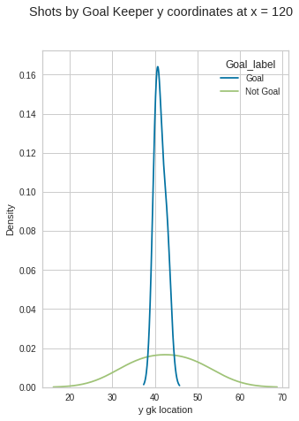
Impact of Goalkeeper location

Slide 23
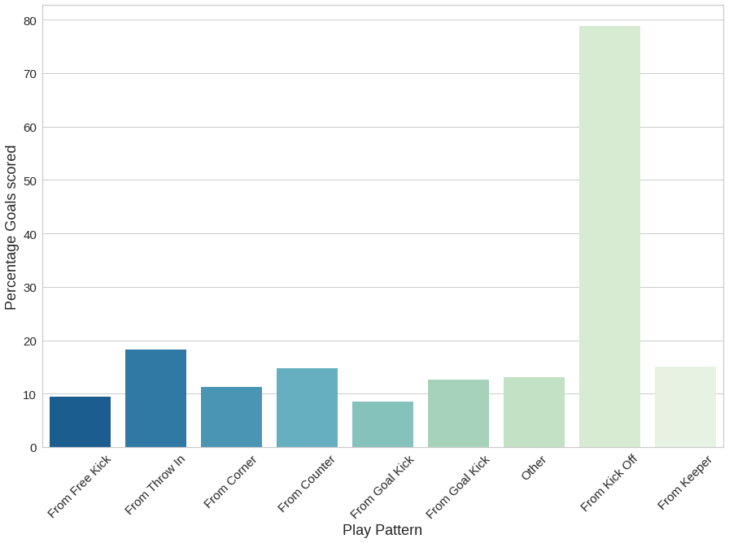
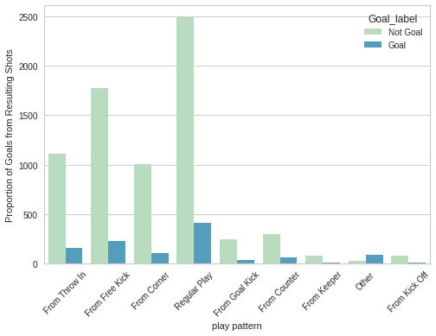
Impact of Play Pattern

Slide 24
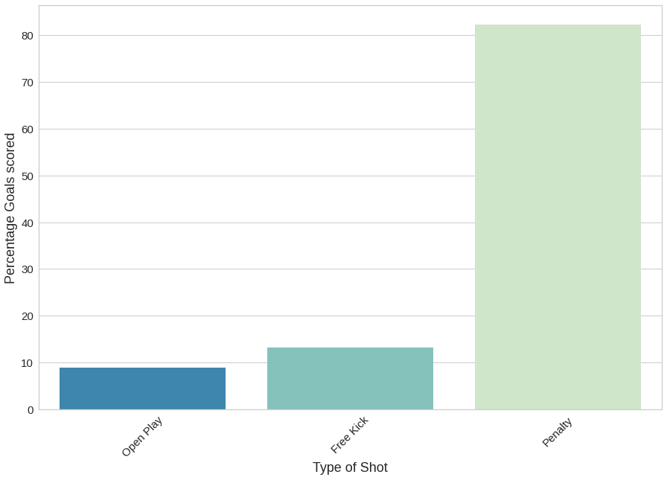
Set Pieces and Open Plays

Slide 25
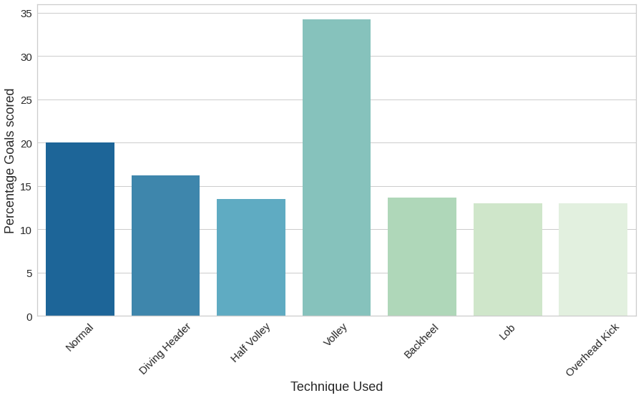
Impact of Shot Technique Used

Slide 26
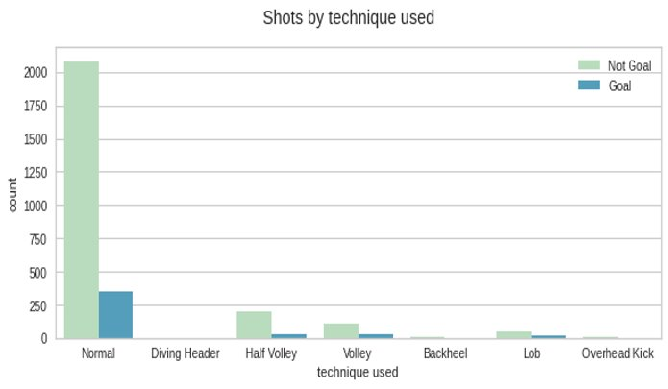
Impact of Shot Technique used

Slide 27
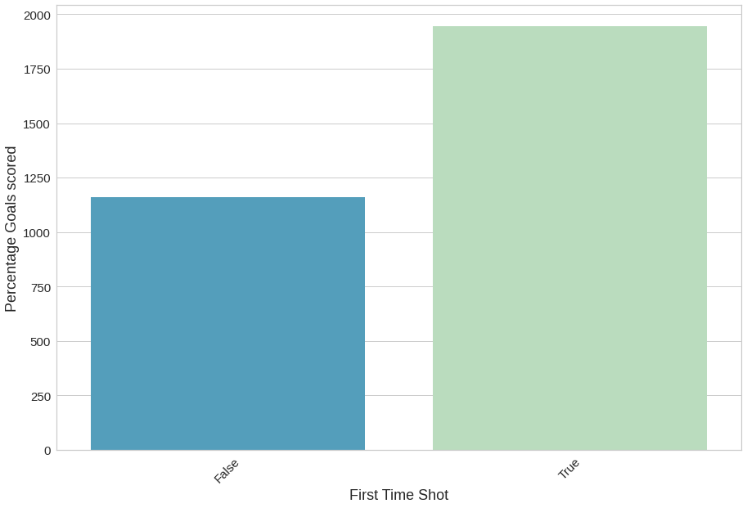
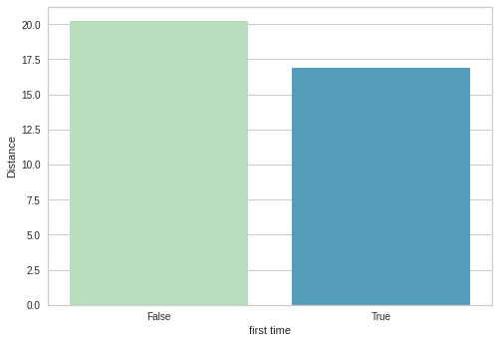
Impact of Shot Timing

Slide 28

MACHINE LEARNING

Slide 29

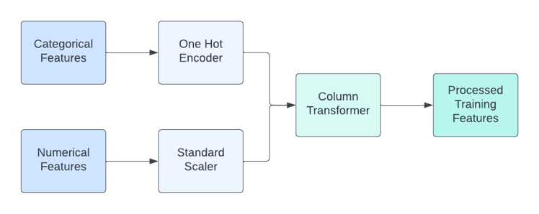
Feature Engineering
Numerical Features
Shot distance
Shot angle
Number of Opponents (5 yards)
Players between goal
X location shot
Y location shot
X gk location
Y gk location
Categorical Features
Pass Type
Body Part Type
Play Pattern
First Time
Technique Used

Slide 30
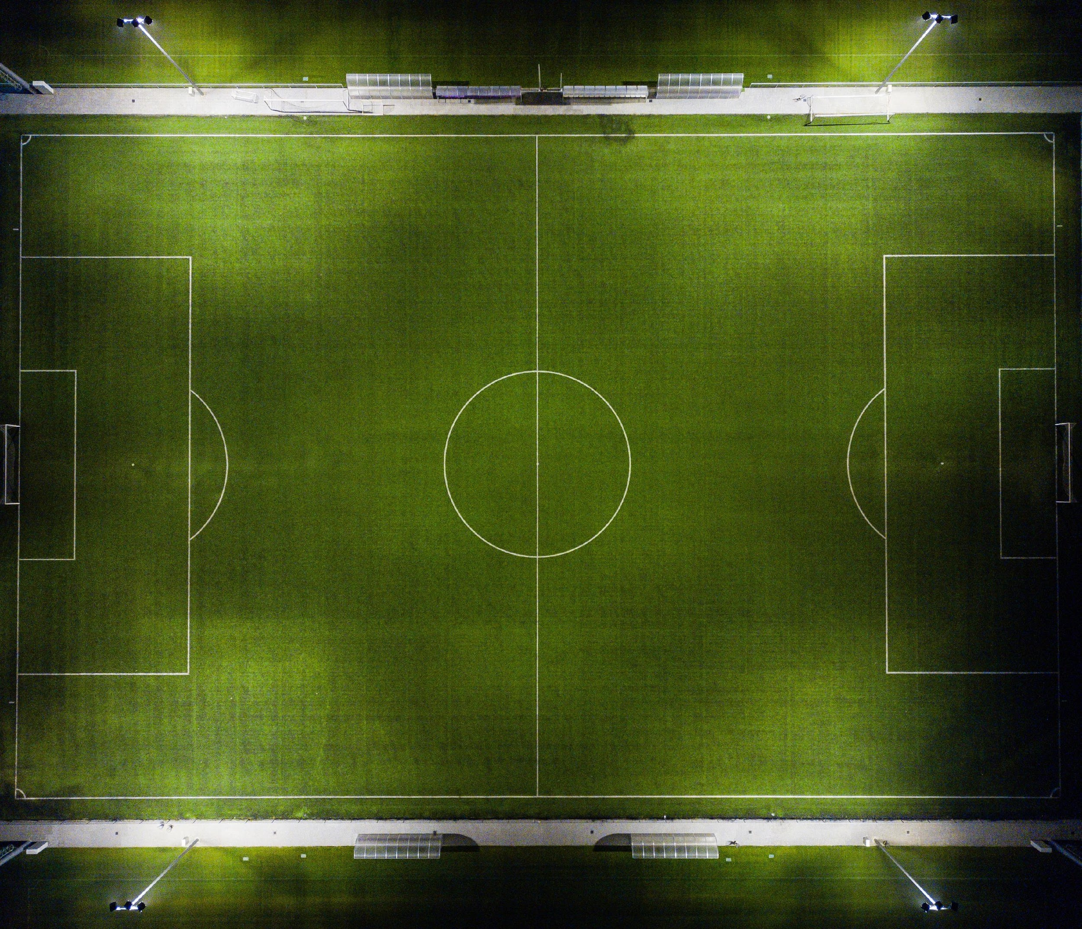



Models Implemented
Logistic Regression
XGBoost
LightGBM
CatBoost

Slide 31
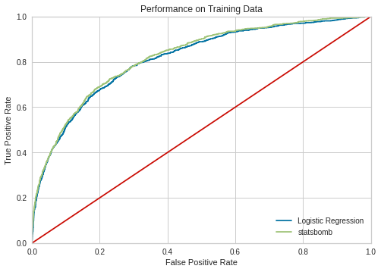
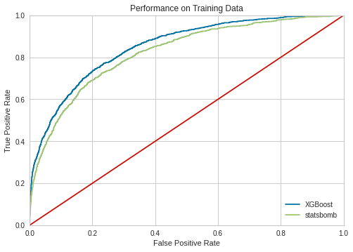
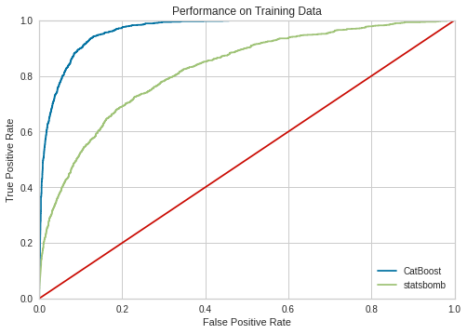

Validation Curves

Slide 32

Hyperparameter Optimization
CatBoost
LightGBM
XGBoost
Logistic Regression
Learning Rate: 0.4825712333803904
Max Depth: 1
Number of estimators: 242
Best cross validation score:
0.309191077199548
Learning Rate: 0.15464158555003027
Max Depth: 3
Number of Leaves: 17
Best cross validation score:
0.3091509664435946
ETA: 0.8935527569726495
Max Depth: 3
Number of Leaves: 15
Best cross validation score:
0.3055891194863476
'C': 12450.545199447934}
Best cross validation score:
0.3089346053470927

Slide 33
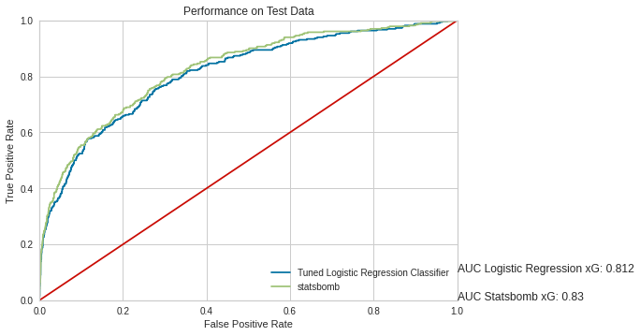
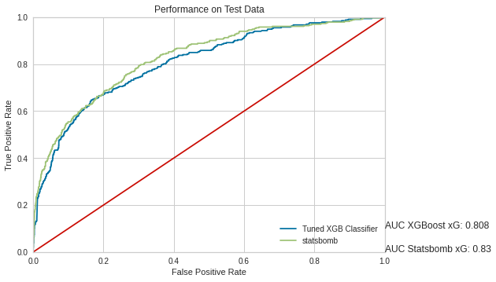
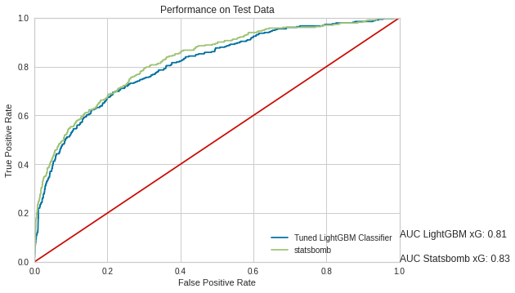
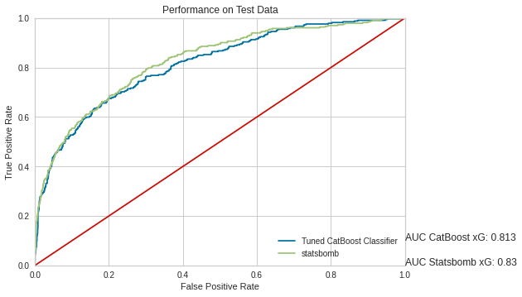
Validation after Hyperparameter Tuning

Slide 34
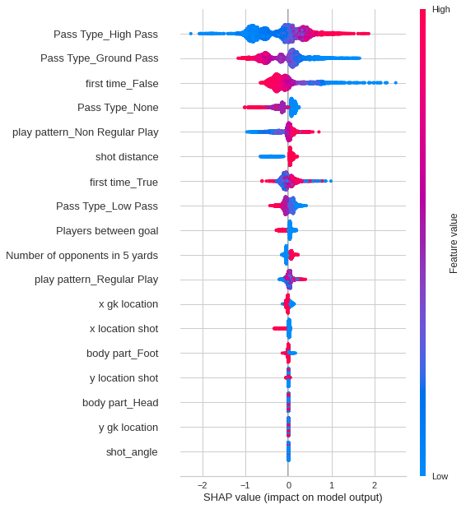
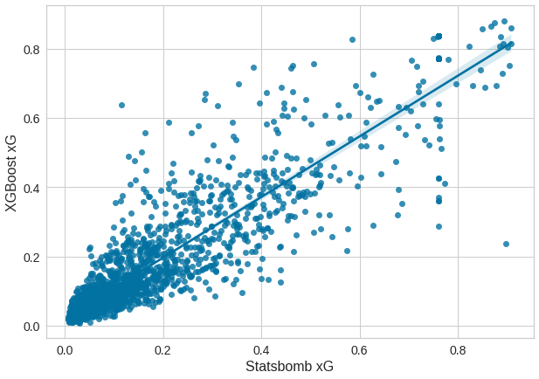

Feature Weights and Outcome Scatter

Slide 35
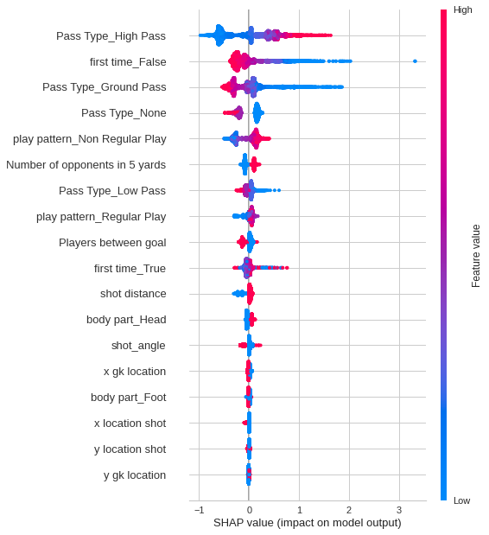
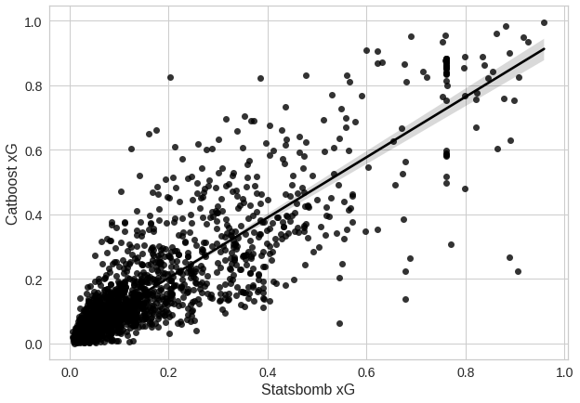
Feature Weights and Outcome Scatter

Slide 36
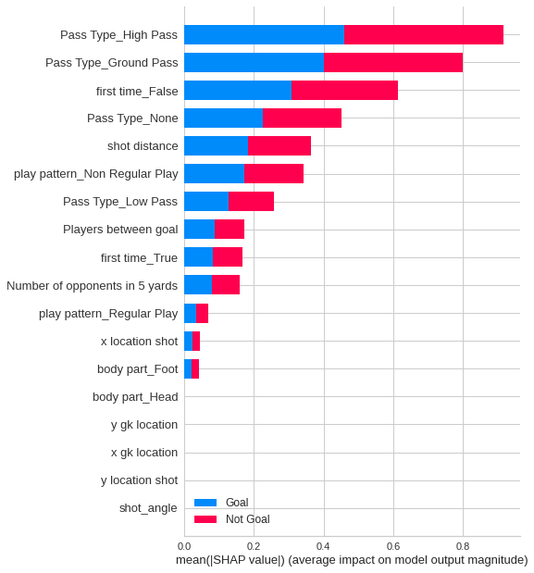
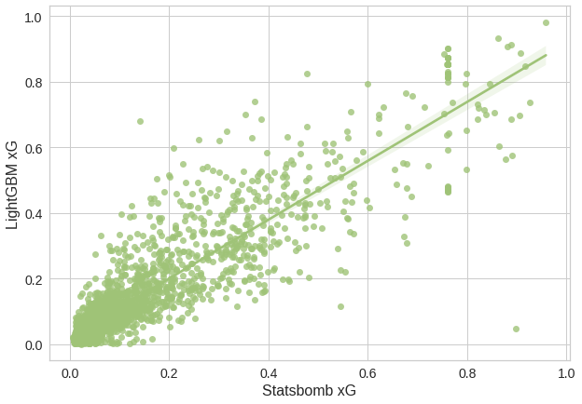
Feature Weights and Outcome Scatter

Slide 37

Feature Weights and Outcome Scatter

Slide 38

Feature Importances

Slide 39


Feature Weights and Outcome Scatter

Slide 40


Feature Weights and Outcome Scatter

Slide 41


Feature Weights and Outcome Scatter

Slide 42


Binary Class Probability Output

Slide 43


Binary Class Probability Output

Slide 44


Player Comparison
Suarez overperformed and Iniesta underperformed as per their expected goals output.
Their 100 chances were very different in quality and their output reflected that.

Slide 45

Player Charts

Slide 46

Player and Team Performances

Slide 47


Multiclass Probability Results

Slide 48


Some Irregularities

Slide 49


Correlation Heatmaps

Slide 50

THANK YOU

